Slide 1
How To Achieve World(-Ready) Domination In Silverlight
Guy Smith-Ferrier
guy@guysmithferrier.com
Blog: http://www.guysmithferrier.com

Slide 2
About…
Author of .NET Internationalization
Visit http://www.dotneti18n.com to download the complete source code
The .NET Developer Network
http://www.dotnetdevnet.com
Free user group for .NET developers, architects and IT Pros based in Bristol
DDD South West
http://www.dddsouthwest.com
Taunton, Saturday 23rd May 2009

Slide 3
Agenda
Localizing Silverlight Using .resx Files
Downloading Localized Resources On Demand
Silverlight Installation User Experience
Silverlight UI Localization
Silverlight Fonts and Font Management
Silverlight Globalization

Slide 4
Localizing Silverlight Using .resx Files
Using Visual Studio 2008 create a new Silverlight app
Add a button
Add a Resources File (In Solution Explorer, right click WpfApplication1, select Add | New Item, select Resources File) and call it PageResources.resx
Add a new resource entry called "Button_1" with a value of "Hello World"
Set the Access Modifier to Public (using the combo box)
Change the constructor to public in PageResources.Designer.cs
<Button Content="Hello World"/>

Slide 5
Localizing Silverlight Using .resx Files (continued)
In Page.xaml add a "Resources" namespace, a static resource and change the button to use a static resource
<UserControl x:Class="SilverlightApplication1.Page"
xmlns="http://schemas.microsoft.com/winfx/2006/xaml/presentation"
xmlns:x="http://schemas.microsoft.com/winfx/2006/xaml"
xmlns:Resources="clr-namespace:SilverlightApplication1"
Width="400" Height="300">
<UserControl.Resources>
<Resources:PageResources x:Name="PageResources"/>
</UserControl.Resources>
<Grid x:Name="LayoutRoot" Background="White">
<Button Content="{Binding Button_1, Source={StaticResource PageResources}}"/>
</Grid>
</UserControl>

Slide 6
Localizing Silverlight Using .resx Files (continued)
In Visual Studio copy PageResources.resx to PageResources.fr-FR.resx
Change the "Button_1" resource value to "Bonjour Le Monde"
Open SilverlightApplication1.csproj using NotePad, locate the SupportedCultures element and set it to fr-FR
<SupportedCultures>fr-FR</SupportedCultures>

Slide 7
Localizing Silverlight Using .resx Files (continued)
Open SilverlightApplication1TestPage.aspx and add InitParameters to the Silverlight control
<asp:Silverlight ID="Xaml1" runat="server" Source="~/ClientBin/SilverlightApplication1.xap" MinimumVersion="2.0.31005.0" Width="100%" Height="100%" InitParameters="UICulture=fr-FR" />

Slide 8
Localizing Silverlight Using .resx Files (continued)
In App.xaml.cs change the Application_Startup method
Run the application
private void Application_Startup(
object sender, StartupEventArgs e)
{
string cultureName = e.InitParams["UICulture"].ToString();
if (! String.IsNullOrEmpty(cultureName))
Thread.CurrentThread.CurrentUICulture =
new CultureInfo(cultureName);
this.RootVisual = new Page();
}

Slide 9
Solutions To The Internal Constructor
1. Use a different Strongly Typed Resource Class code generator
PublicResourceCodeGenerator
http://www.dotneti18n.com/Downloads/ResourceProviderCodeGenerators.zip
ResXFileCodeGeneratorEx
http://dmytro.kryvko.googlepages.com

Slide 10
Solutions To The Internal Constructor (continued)
2. Write a wrapper for the Strongly Typed Resource Class and bind to the wrapper
public class PublicPageResources
{
private static PageResources resources = new PageResources();
public PageResources { get { return resources; } }
}
<UserControl.Resources>
<Resources:PublicPageResources x:Name="PageResources"/>
</UserControl.Resources>

Slide 11
Setting The Silverlight Culture From ASP.NET
Add the following directives to the ASP.NET Page attribute:-
Add the following script to the ASP.NET page:-
UICulture="auto" Culture="auto"
<script runat="server">
protected void Page_Load(object sender, EventArgs e)
{
Xaml1.InitParameters = "UICulture=" + System.
Threading.Thread.CurrentThread.CurrentUICulture.Name;
}
</script>

Slide 12
Setting The Silverlight Culture From ASP.NET (continued)
Delete the InitParameters from the Silverlight control
Add a Spanish(Spain) .resx file for PageResources
Change the SupportedCultures in the .csproj file
<SupportedCultures>fr-FR,es-ES</SupportedCultures>

Slide 13
Download On Demand Creating The Resource XAP File Manually
Copy bin\debug\AppManifest.xaml to bin\debug\fr-FR
Ensure that the only AssemblyPart is:-
Create a ZIP file, fr-FR.zip, containing:-
AppManifest.xaml with no path information
SilverlightApplication1.resources.dll with fr-FR path
Rename fr-FR.zip to fr-FR.xap
Copy fr-FR.xap to SilverlightApplication1.Web\ClientBin
<AssemblyPart Source=
"fr-FR/SilverlightApplication1.resources.dll" />

Slide 14
Download On Demand Creating The Resource Xap File Automatically
Download the XapResourcePackager task from http://www.guysmithferrier.com
Create an msbuild project to use the XapResourcePackager task:-
<UsingTask TaskName="XapResourcePackager"
AssemblyFile="Silverlight.Build.Tasks.dll"/>
<Target Name="BuildXap">
<XapResourcePackager
XapResourceFilename="$(XapResourceFilename)"
AssemblyName="$(AssemblyName)"
SourceFiles="@(SourceFiles)"
XapResourceFileCultureName="$(XapResourceFileCultureName)"/>
</Target>

Slide 15
Download On Demand Changing The Silverlight Application
Empty the SupportedCultures in the .csproj file
Change the Application_Startup event to:-
<SupportedCultures></SupportedCultures>
private void Application_Startup(object sender, StartupEventArgs e)
{
string cultureName = e.InitParams["UICulture"];
if (!String.IsNullOrEmpty(cultureName))
{
Thread.CurrentThread.CurrentUICulture = new CultureInfo(cultureName);
XapResourceLoader.Load();
}
else
this.RootVisual = new Page();
}

Slide 16
Download On Demand Changing The Silverlight Application
Add the following lines to the App constructor
Add the following method to the App class
XapResourceLoader.AssemblyFilename =
App.Current.GetType().Assembly.FullName.Split(',')[0];
XapResourceLoader.OpenReadCompleted +=
new OpenReadCompletedEventHandler(
XapResourceLoader_OpenReadCompleted);
private void XapResourceLoader_OpenReadCompleted(
object sender, OpenReadCompletedEventArgs e)
{
this.RootVisual = new Page();
}

Slide 17
Download On Demand XapResourceLoader Class
public static event OpenReadCompletedEventHandler OpenReadCompleted;
public static string AssemblyFilename { get; set; }
public static void Load()
{
WebClient webClient = new WebClient();
webClient.OpenReadCompleted += new
OpenReadCompletedEventHandler(InternalOpenReadCompleted);
if (OpenReadCompleted != null)
{
webClient.OpenReadCompleted += OpenReadCompleted;
}
Uri cultureUri = new Uri(String.Format("{0}.xap",
Thread.CurrentThread.CurrentUICulture.Name),
UriKind.Relative);
webClient.OpenReadAsync(cultureUri);
}

Slide 18
Download On Demand XapResourceLoader Class
private static void InternalOpenReadCompleted(
object sender, OpenReadCompletedEventArgs e)
{
if (e.Error == null && !e.Cancelled)
{
Stream xapStream = e.Result;
Uri resourcesAssemblyUri =
new Uri(GetResourcesAssemblyPath(), UriKind.Relative);
StreamResourceInfo xapStreamResourceInfo =
new StreamResourceInfo(xapStream, null);
StreamResourceInfo resourcesAssemblyStreamResourceInfo =
Application.GetResourceStream(
xapStreamResourceInfo, resourcesAssemblyUri);
if (resourcesAssemblyStreamResourceInfo != null)
{
AssemblyPart assemblyPart = new AssemblyPart();
assemblyPart.Load(resourcesAssemblyStreamResourceInfo.Stream);
}
}
}

Slide 19
Download On Demand XapResourceLoader Class
private static string GetResourcesAssemblyPath()
{
// e.g. "fr-FR/SilverlightApplication1.resources.dll"
return Thread.CurrentThread.CurrentUICulture.Name + "/" +
AssemblyFilename + ".resources.dll";
}

Slide 20
Silverlight Installation User Experience
The Silverlight install image is retrieved from http://go.microsoft.com/fwlink/?LinkId=108181
This reads the browser's HTTP accept language setting and returns an image for that culture
English
French
Spanish
Japanese

Slide 21
Silverlight Installation User Experience (continued)
The Silverlight add-in is installed using a Windows application
The Windows application uses the operating system's culture (e.g. en-US) to determine the localized resources to display
If you set your browser's language to a different language to your operating you will see a schizophrenic installation experience

Slide 22
Silverlight Installation Testing Tip
To save from having to uninstall and reinstall Silverlight to test the installation experience disable Silverlight:-
In Internet Explorer select Tools | Manage Add-ons | Enable or Disable Add-ons
Select Microsoft Silverlight and click on the Disable radio button

Slide 23
Silverlight Runtime Culture Support
Silverlight is a single runtime that includes all supported languages:-
English (en-US)
French (fr)
German (de)
Italian (it)
Japanese (jp)
Korean (ko)
Spanish (es)
Chinese Simplified (zh-Hans)
Chinese Traditional (zh-Hant)

Slide 24
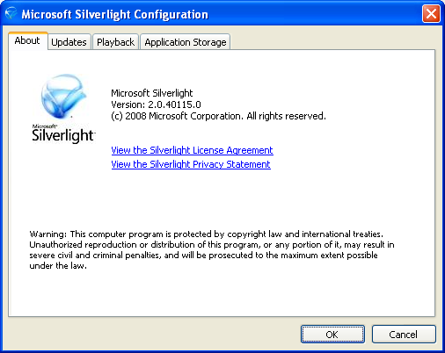
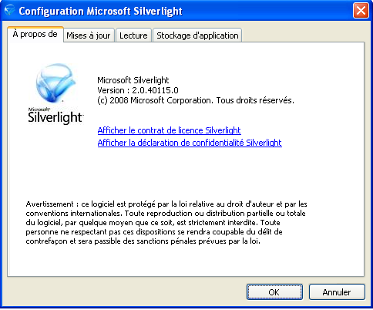
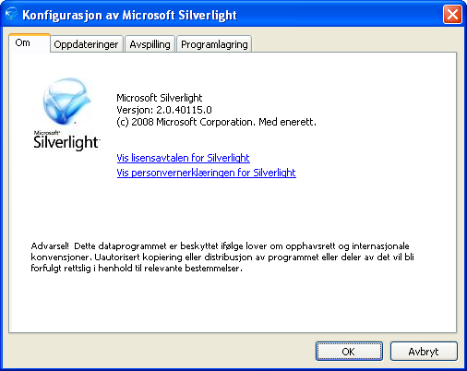
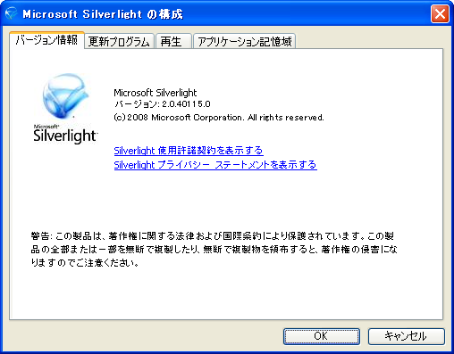
Silverlight Configuration Dialog
The Config dialog's UI is dictated by the operating system (only)
Defaults to English

Slide 25
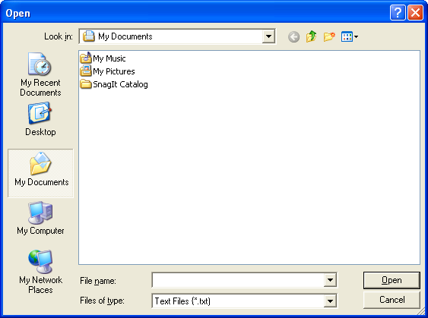
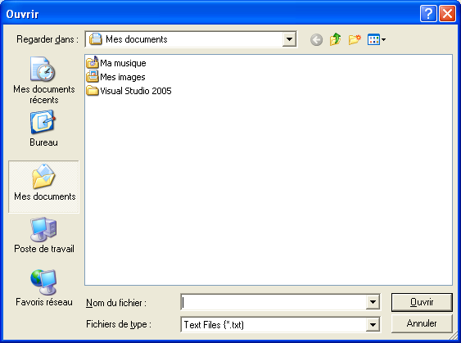
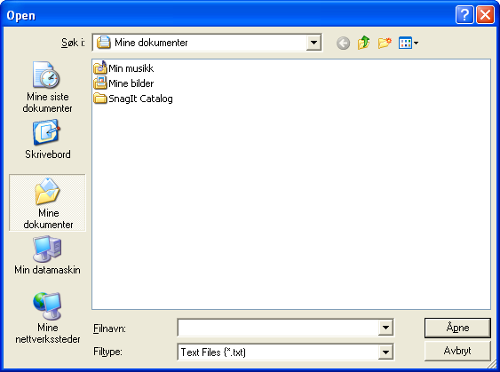
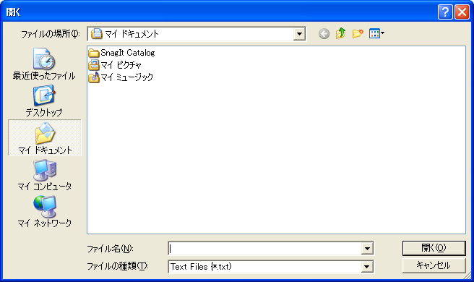
Silverlight Message & File Dialogs (MessageBox, OpenFileDialog, SaveFileDialog)
These dialogs' UIs are dictated by the operating system (only)

Slide 26
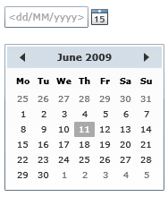
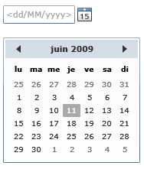
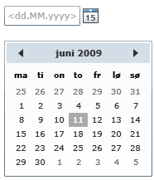
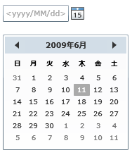
Silverlight Globalized Controls
The DatePicker and Calendar controls respect the Thread.CurrentCulture setting
en-GB
fr-FR
nb-NO
ja-JP

Slide 27
Localization And Globalization Sources Summary
UI Element | Origin | Controlled By
.aspx/.ascx pages/controls | Your application | CurrentUICulture (& CurrentCulture)
Silverlight install image | Microsoft's server | Browser's HTTP ACCEPT LANGUAGE
Silverlight install dialogs | Silverlight install package | OS's UI Culture
Silverlight application | Your application | CurrentUICulture (& CurrentCulture)
Silverlight config dialog | Silverlight runtime | OS's UI Culture
Silverlight file dialogs | Client's operating system | OS's UI Culture
Silverlight controls | Silverlight runtime | CurrentUICulture (& CurrentCulture)

Slide 28
Silverlight Fonts
Silverlight supports 9 fonts on all platforms

Slide 29
Font Fallback
If you use a font that is not in the list Silverlight asks the operating system for the font
The operating system uses Font Fallback to find the best match for unknown fonts
Lucida Sans Unicode on Windows Vista Ultimate
Lucida Sans Unicode on Windows XP SP2 (East Asian support not installed)

Slide 30
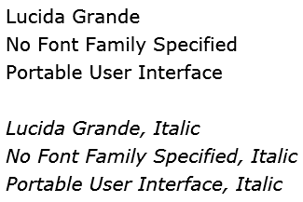
Silverlight Default Font
Silverlight uses the "Portable User Interface" font by default
The "Portable User Interface" font is an alias for Lucida Grande

Slide 31
Using Non-Silverlight Fonts
Create a new Silverlight project
Add a folder called Fonts
Add a font, Oz.ttf, to the Fonts folder
Ensure that Build Action is set to Resource
Add a button to Page.xaml:-
<Button FontFamily="Fonts/Oz.ttf#Australian"
Content="Hello World"/>

Slide 32
Downloading Fonts Asynchronously
Delete the FontFamily from the Button control
Select Oz.ttf in the Fonts folder, set Build Action to None
Create a Fonts folder in the web project and add the font file to the folder
Add a click event with the following code:-
private void Button_Click(object sender, RoutedEventArgs e)
{
WebClient webClient = new WebClient();
webClient.OpenReadCompleted += new
OpenReadCompletedEventHandler(OpenReadCompleted);
webClient.OpenReadAsync(
new Uri("/Fonts/Oz.ttf", UriKind.Relative));
}

Slide 33
Downloading Fonts Asynchronously (continued)
Add a TextBlock to the page
Add the following code:-
Only TextBlock and TextBox have a FontSource property
private void OpenReadCompleted(object sender,
OpenReadCompletedEventArgs e)
{
this.TextBlock1.FontSource = new FontSource(e.Result);
this.TextBlock1.FontFamily = new FontFamily("Australian");
this.TextBlock1.Text = "The font has landed";
}

Slide 34
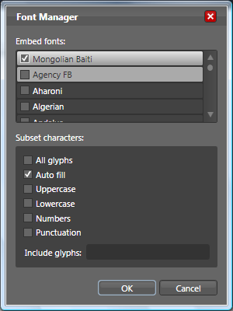
Font Subsetting
Open a Silverlight project in Blend 2 or above
Add a font
Tools | Font Manager
Select Mongolian Baiti (349K)
Check the "Auto fill" checkbox
Add a TextBlock, set the Font Family to the new font and set the Content to "Hello World"
Build the project

Slide 35
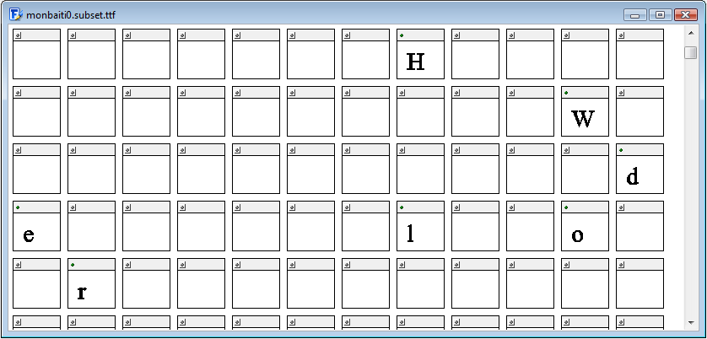
Font Subsetting (continued)
Open the subsetted font (obj\Debug\Fonts\monbaiti0.subset.ttf, 101K)

Slide 36
Font Subsetting MSBuild Tasks
When you add a Font to your project Blend does the following:-
Adds "SubsetFont.targets" to the project root folder
Adds "SubsetFontTask.dll" to the project root folder
Adds the following line to the .csproj file:-
<Import Project="SubsetFont.targets" />

Slide 37
Silverlight Globalization Namespace
Comparison between the .NET Framework and the Silverlight Framework:-
http://www.guysmithferrier.com/downloads/SilverlightGlobalizationClassComparison.pdf
No support for locale IDs (LCIDs)
No lunisolar calendars
No Windows-specific features
CultureInfo.ThreeLetterWindowsLanguageName
RegionInfo.GeoId
No code page support (Unicode only)

Slide 38
Custom Cultures
The CultureAndRegionInfoBuilder class is not supported in Silverlight
Silverlight does read custom cultures if they are present on the client's operating system

Slide 39
Right To Left Support
No built in support in Silverlight 2 and 3
FrameworkElement.FlowDirection is not supported
Expected for Silverlight 4
Almost all workarounds require the creation of a separate RTL version of the Silverlight application

Slide 40
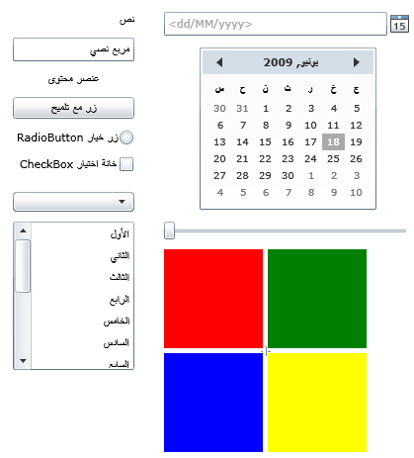
Silverlight 2.0 Hebrew & Arabic Language Support
A library of Silverlight RTL controls
http://silverlightrtl.codeplex.com

Slide 41
Other WPF I18N Features Not Available In Silverlight
Static markup extension is not supported
Silverlight's MarkupExtension is not public
See "Differences Between WPF and Silverlight"
http://wpfslguidance.codeplex.com

Slide 42
Silverlight On Windows vs. Silverlight On Mac OS X
Culture data varies across operating systems
Sort, casing and comparison results vary across operating systems

Slide 43
Summary
Localization is possible through .resx files
Bind to the strongly typed resource classes
If you have more than one culture you should consider "download on demand"
Avoiding a schizophrenic user interface can be a challenge
Globalization support is dependent upon the operating system

